Slide 1
Legal Obligations of Programmers
Software Development
Unit 4 Outcome 1

Slide 2
Legal Obligations of Programmers
One of the key skills you need to demonstrate is your ability to explain how solutions have taken into account legal obligations of programmers.

Slide 3

VCAA 2008 Section C
Question 8
Part of Pattie’s agreement with Baron Software is to keep development costs to a minimum. When the programmers are discussing how best to store the client quotes on the mobile device, one programmer, Schroeder, argues that they must include encryption. Another programmer, Sally, disagrees as encryption will increase the overall development cost.
Discuss the ethical considerations from each point of view.
4 marks
Notes:
Examples of exam questions.

Slide 4
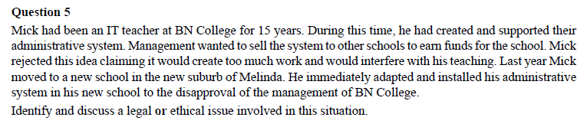

VCAA Section B 2007

Slide 5

So what are the legal obligations?

Slide 6
These are the acts that you need to know the essence of.
Copyright Act (1968)
  Who owns software code?
Privacy Act (1988) and Information Privacy Act (2000)
  The care you need to take with peoples data.
Health Records Act (2001)
  Similar to privacy but involving your medical history and data.
Charter of Human Rights and Responsibilities Act (2006)
  Basic rights Victorian’s have. (Privacy, free speech, religion, no slavery)
Spam Act (2003)
  No spam allowed.

Slide 7

Privacy Act 1988 and the Information Privacy Act 2000
Australian laws that state how organisations deal with personal data.

Slide 8
Privacy Act 1988 and the Information Privacy Act 2000
There is now a government department called the “Office of the Australian Information Commissioner” who deals with the issues of information collection, storage, distribution and privacy.
The laws are based around Information Privacy Principles.

Slide 9

Information Privacy Principles (IPP)
IPP 1: manner and purpose of collection
The information must be necessary for the agency's work, and collected fairly and lawfully.
Notes:
So you can’t ask what brand of deoderant someone uses when applying for a bank loan.

Slide 10

Information Privacy Principles (IPP)
IPP 2: collecting information directly from individuals
An agency must take steps to tell individuals why they are collecting personal information, what laws give them authority to collect it, and to whom they usually disclose it. This is often done by what is called an IPP 2 notice.
Notes:
What personal information we collect
When you create an Apple ID, register your products, apply for commercial credit, purchase a product, download a software update, register for a class at an Apple Retail Store or participate in an online survey, we may collect a variety of information, including your name, mailing address, phone number, email address, contact preferences and credit card information.
When you share your content with family and friends using Apple products, send gift certificates and products, or invite others to join you on Apple forums, Apple may collect the information you provide about those people such as name, mailing address, email address and phone number.
How we use your personal information
The personal information we collect allows us to keep you posted on Apple’s latest product announcements, software updates and upcoming events. It also helps us to improve our services, content and advertising. If you don’t want to be on our mailing list, you can opt out anytime by updating your preferences.
We also use personal information to help us develop, deliver and improve our products, services, content and advertising.
From time to time, we may use your personal information to send important notices, such as communications about purchases and changes to our terms, conditions and policies. Because this information is important to your interaction with Apple, you may not opt out of receiving these communications.
We may also use personal information for internal purposes such as auditing, data analysis and research to improve Apple’s products, services and customer communications.
If you enter into a sweepstake, contest or similar promotion we may use the information you provide to administer those programs.

Slide 11

Information Privacy Principles (IPP)
IPP 3: collecting information generally
An agency must take steps to ensure the personal information it collects is relevant, up-to-date and complete and not collected in an unreasonably intrusive way.
Notes:
If you got expelled from school and then appealed that you were wrong done by. It would be up to the supermarket to record that you were not actually expelled. Also if you send an e-mail out to a client and it keeps bouncing is up to you to update the information
Collected fairly means if someone asks you not to call you at work, you don’t

Slide 12

Information Privacy Principles (IPP)
IPP 4: storage and security
Personal information must be stored securely to prevent its loss or misuse.
Notes:
Vodaphone got a rap over the knuckles at the start of the year when their personal data was accesable over the net via a generic username and password. But the privacy act did not allow the privacy commisioner to give any penalty. However, the breach may open up a way for customers to sue for damages. They also got accused of passing info on o third parties illegally.

Slide 13

Information Privacy Principles (IPP)
IPPs 5 - 7: access and amendment
These principles require agencies to take steps to record the type of personal information that they hold and to give individuals access to personal information about them. Personal information can be amended or corrected if it is wrong.

Slide 14
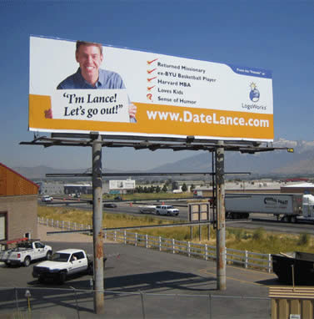
Information Privacy Principles (IPP)
IPPs 8 - 10: information use
These principles outline the rules about keeping accurate, complete and up-to-date personal information; using information for a relevant purpose; and only using the information for another purpose in special circumstances, such as with the individual's consent or for some health and safety or law enforcement reasons.
Notes:
So part 2 was about you must tell the person what you are going to do, this bit is about actually doing what you tell the person you are going to do.

Slide 15
Did Lance agree to this use of his personal information? (Probably)

Slide 16

Information Privacy Principles (IPP)
IPP 11: disclosure
This principle sets out when an agency may disclose personal information to someone else, for example another agency. This can only be done in special circumstances, such as with the individual's consent or for some health and safety or law enforcement reasons.

Slide 17
Can you remember IPPs?

Slide 18

Copyright Act (1968)
The Copyright Act defines a computer program as: “a set of statements or instructions to be used directly or indirectly in a computer in order to bring about a certain result.”
When software is created, the company that creates the software automatically owns the copyright. If there is no company, it is the individual.

Slide 19
What can I do If I own the Copyright?
Reproduce the software, eg HDD to CD.
Edit the algorithms in the software.
Publish the program to the public (sell it).
Adapt the program (eg new version, different programming language).
Communicate the program to the public. eg put it on the web to download, send to someone in an e-mail.

Slide 20
If you don’t hold the copyright?
You are breaking the law if you do those just mentioned things unless you have the copyright holders permission.
Permission includes the details set out in the licence agreement.
However, copyright does not cover the function of the program. If someone else creates a program that has the same function, you can’t claim copyright.
You are also permitted to create a backup copy of the program, but you can’t give it to anyone else!

Slide 21
What you can do without ownership.
Copy 10% or 1 chapter of a reference book, whichever is greater.
You can record TV and radio shows for personal use legally.
You can change the format of music, eg from CD to iTunes without breaching the act
If its more than 70 years since the creator died you can use it how you want!

Slide 22
A bit more about ownership
If you are working for a company and make awesome software. Your employer gets the copyright not you. This means you are not allowed to copy or modify the software even though you wrote it!
At Uni, as soon as you submit an assignment you are handing over copyright to the Uni! Perhaps failing could be better than losing ownership???

Slide 23
Some Cases:
"A former Goldman Sachs programmer convicted of stealing the bank’s high-speed trading software was sentenced Friday to eight years in prison." http://www.wired.com/threatlevel/2011/03/aleynikov-sentencing/

Slide 24
Health Records Act (2001)
Very similar to the privacy act, applies to all health organisations.
The main difference is that your anonymous medical details can be passed on to organisations conducting medical research without getting your consent first.
Also there is mandatory reporting of some STI’s and specific infectious diseases such as Hendra virus.

Slide 25
Victorian Charter of Human Rights and Responsibilities Act (2006)
Section 13 – Privacy and Reputation
  Privacy we have spoken about.
  You are not allowed to have your reputation unlawfully attacked. This could be spreading false rumours on facebook.

Slide 26
Victorian Charter of Human Rights and Responsibilities Act (2006)
Section 14 -Freedom of thought, conscience, religion and belief.
    You are free to belong to whatever religion / beliefs you choose.
Section 15 – Freedom of Expression
  You are free to express an opinion however you want (written, spoken, art) but you can’t break the law and you must respect other peoples rights to section 13 and 14 (privacy, reputation and freedom of thought)

Slide 27
Spam Act 2003
Spam is the sending of any unsolicited commercial electronic messages. (e-mail, SMS, IM etc) NOT voice.
An e-mail must clearly identify the sender.
An organisation must give you the option of removing yourself from their mailing list and stop sending you e-mails.

Slide 28
Spam Act 2003
It is also illegal to sell e-mail address lists.
And you can’t use harvesting software such as bots to search the internet and compile an e-mail address list.
There are fines up to $1.1 Million for repeat corporate offenders.

Slide 29
VCAA 2008 Section C
Question 8
Part of Pattie’s agreement with Baron Software is to keep development costs to a minimum. When the programmers are discussing how best to store the client quotes on the mobile device, one programmer, Schroeder, argues that they must include encryption. Another programmer, Sally, disagrees as encryption will increase the overall development cost.
Discuss the ethical considerations from each point of view.
4 marks

Slide 30
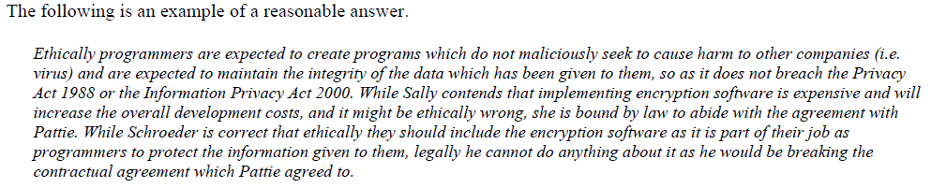
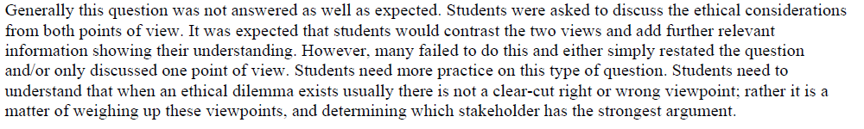

Slide 31
VCAA 2008 Section C
Question 8
Part of Pattie’s agreement with Baron Software is to keep development costs to a minimum. When the programmers are discussing how best to store the client quotes on the mobile device, one programmer, Schroeder, argues that they must include encryption. Another programmer, Sally, disagrees as encryption will increase the overall development cost.
Discuss the ethical considerations from each point of view.
4 marks

Slide 32
VCAA Section B 2007

Slide 34
DO THE CHECK YOUR LEARNING SECTION ON THIS ANZ TRAING SITE:
http://anzetrain.com/courseware/olawlg/aicc/privacy/about/att_01.html

Slide 35
References
Australian Copyright Council (2005), Computer Software & Copyright, Information Sheet GD5Dv09, Australian Government.
Janson, A (2010) Software Development: Core Techniques and Principles adrian janson publishing, Melbourne.
OAIC (2011) IPPs - Plain English Summary, http://www.privacy.gov.au/materials/types/law/view/6892 viewed 1/8/11

